Slide 1



Network forensics

Slide 2

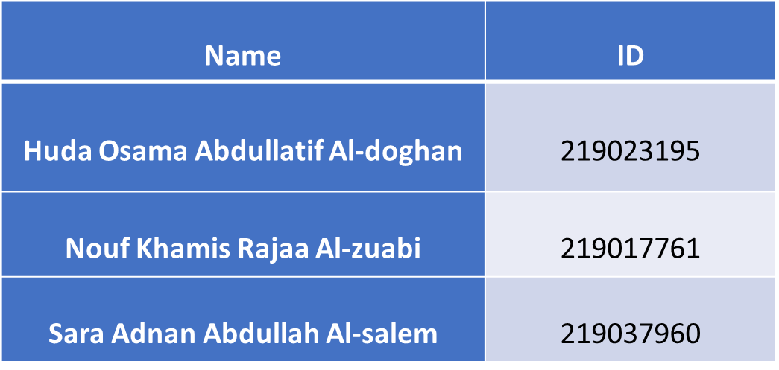
Project Team:

Slide 3

Outline:
Introduction
Man-in-Middle Attack Arp Spoofing Attack DoS Attack Conclusion Reference

Slide 4
Introduction
Network forensics is a specialized field within digital forensics that focuses on the comprehensive examination of network activities and data transmission across networks believed to be engaged in malicious behavior. Its primary objective is to investigate networks involved in activities such as the propagation of malware, credential theft, and the analysis of cyber-attacks.
Now we will make three types of attacks which are Man-in-Middle Attack, Denial of Service (DoS) attack and Arp Spoofing Attack.

Slide 5
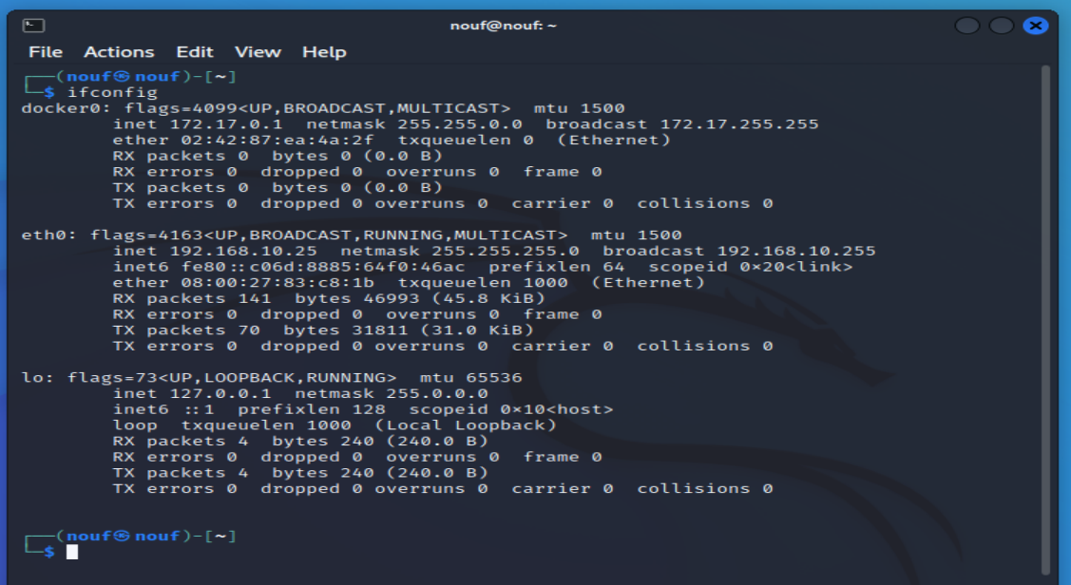
1. Man-in-Middle Attack A man-in-the-middle (MITM) attack is a cyber attack in which a threat actor puts themselves in the middle of two parties, typically a user, to intercept their communications and data exchanges and use them for malicious purposes like making unauthorized purchases or hacking.
Kali IP Address

Slide 6
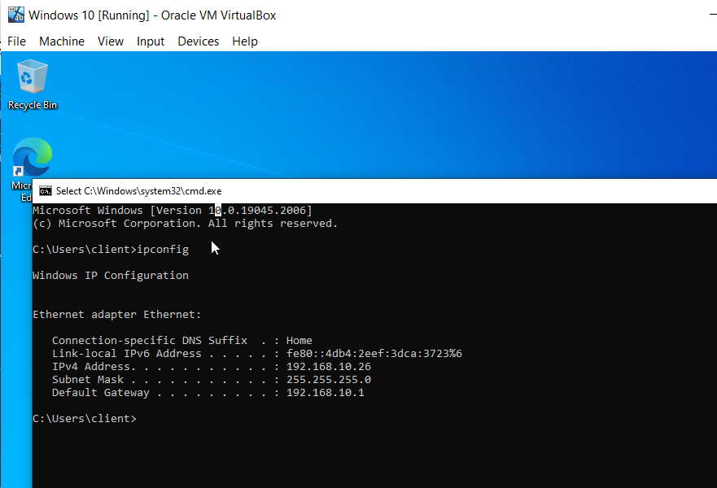
Windows IP Address

Slide 7
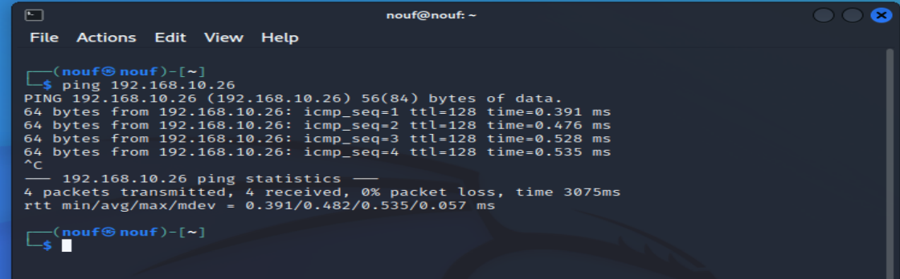
attacker to target ping

Slide 8
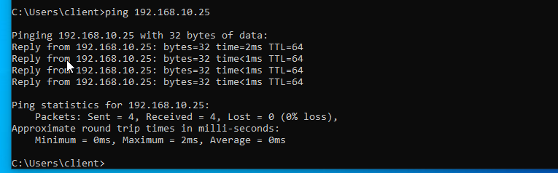
pinging from target to attacker

Slide 9
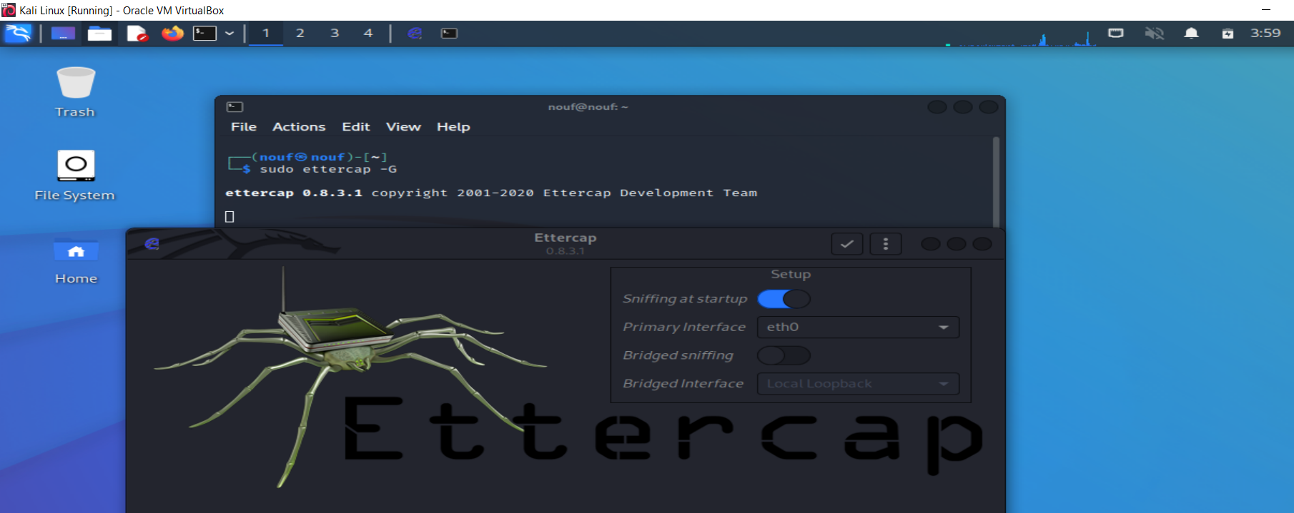
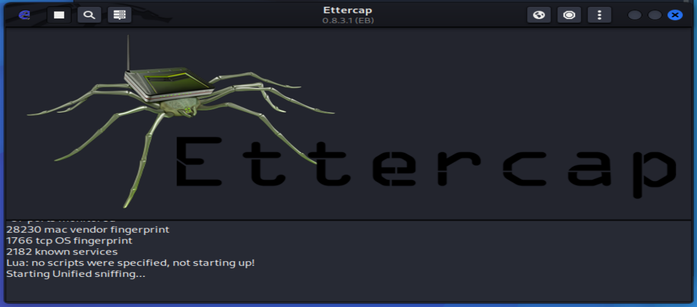
launched Ettercap by this command: sudo etthercap –G

Slide 10
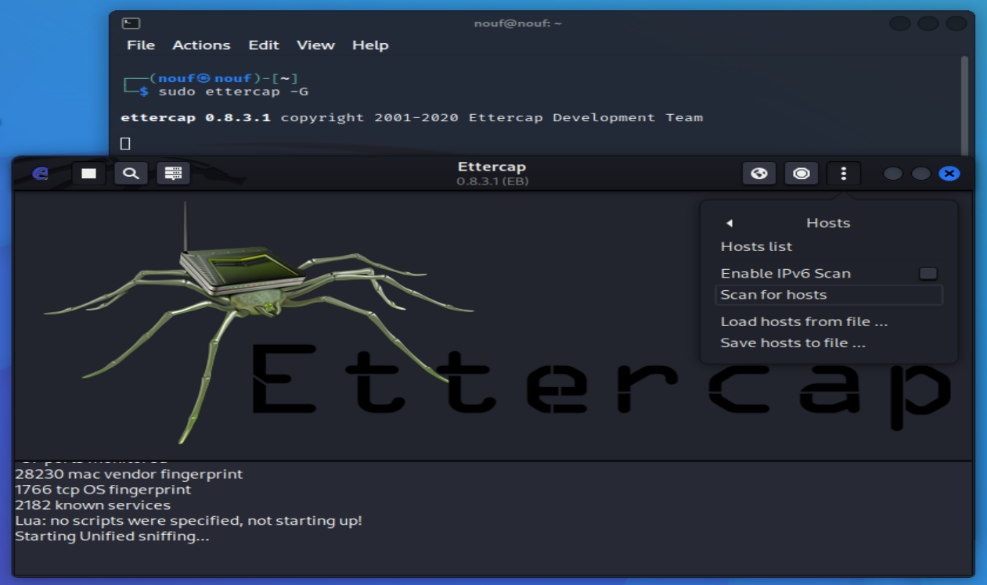
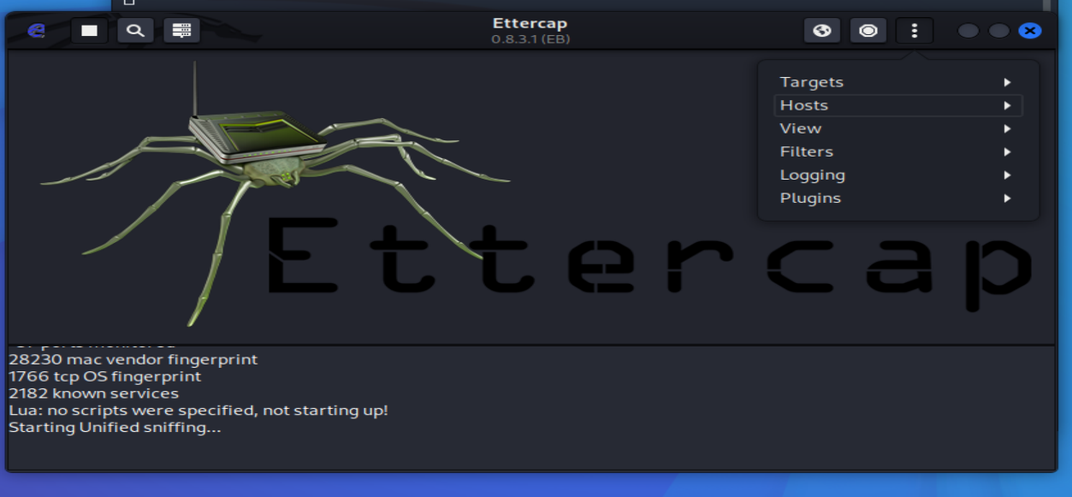
In Ettercap we have check the scaninghosts list and add out target IP as Target 1.

Slide 11
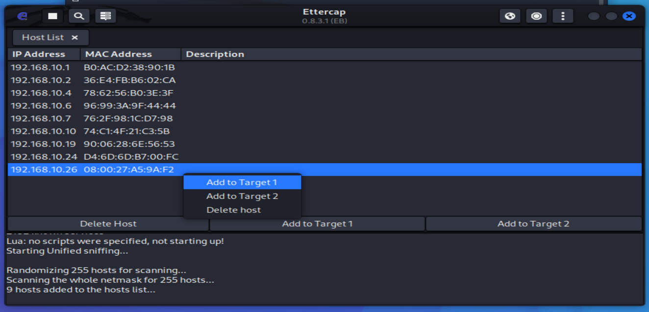
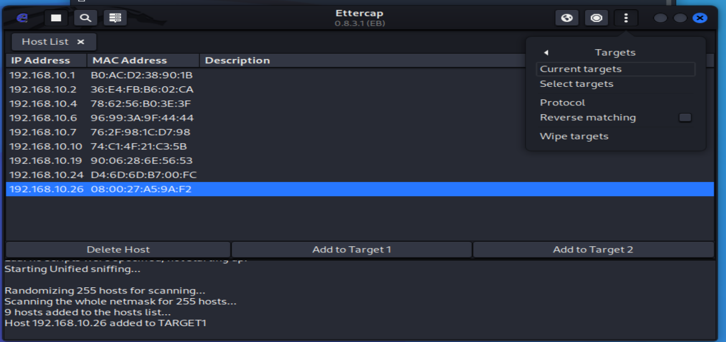
then we have check it by visit the current target.

Slide 12
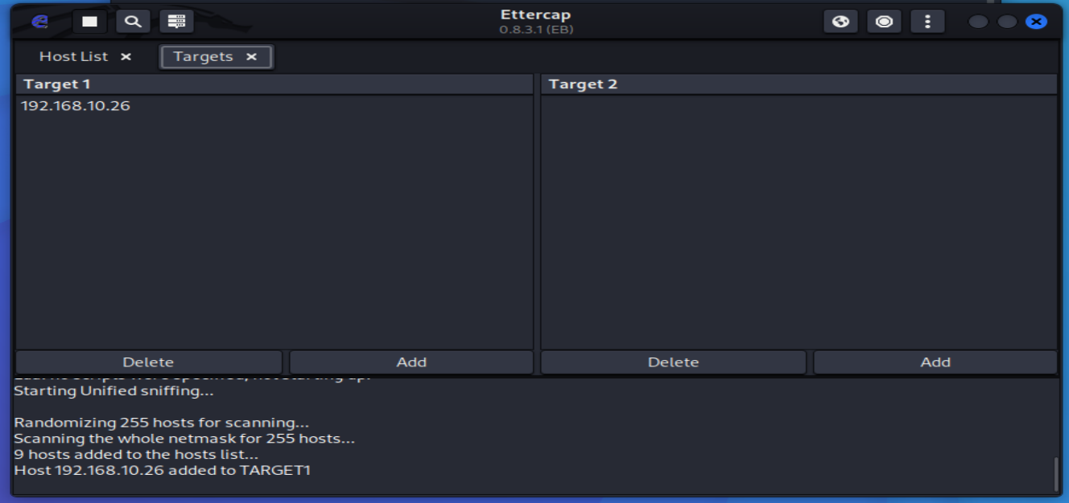

Slide 13
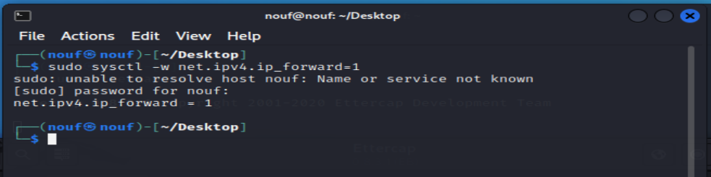
Starting the Spoofing Attack ─$ sudo sysctl -w net.ipv4.ip_forward=1

Slide 14
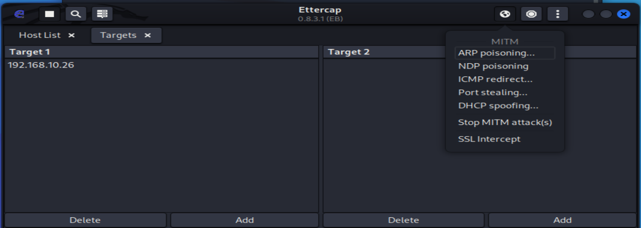
Selecting ARP Poisoning after that the attack will start.

Slide 15
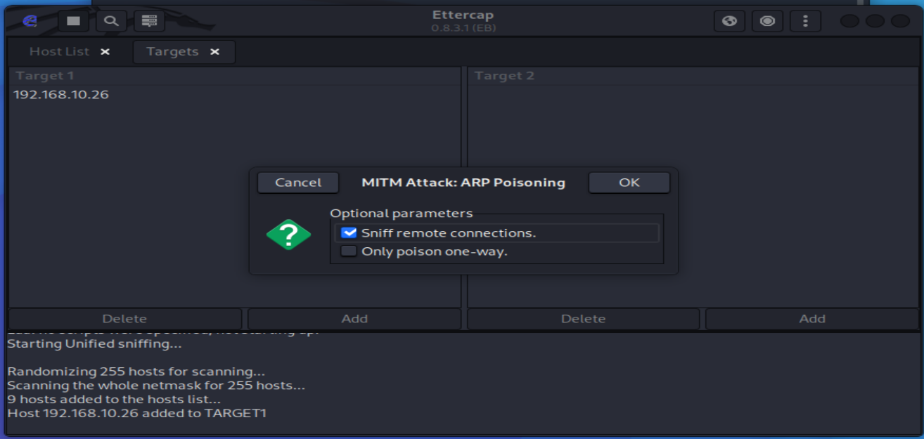
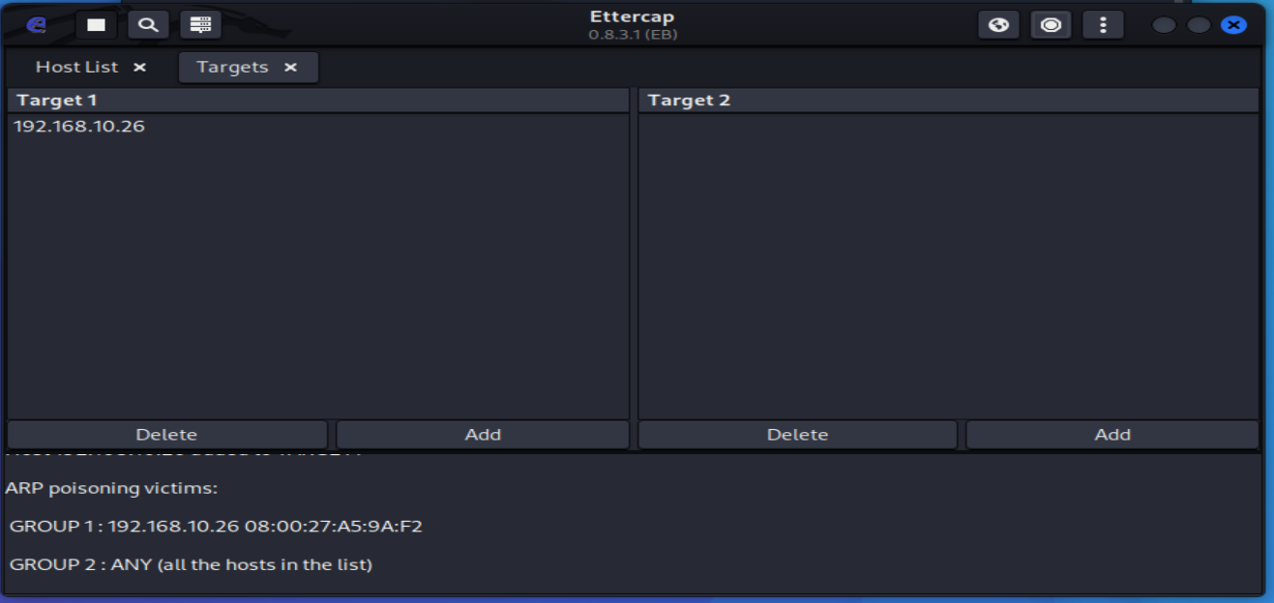

Slide 16
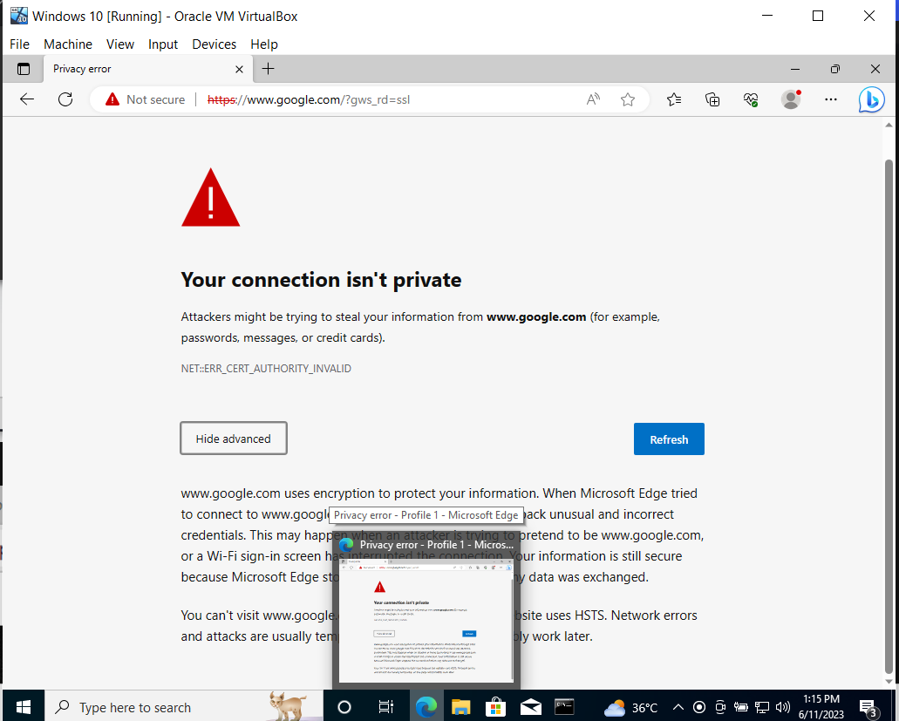
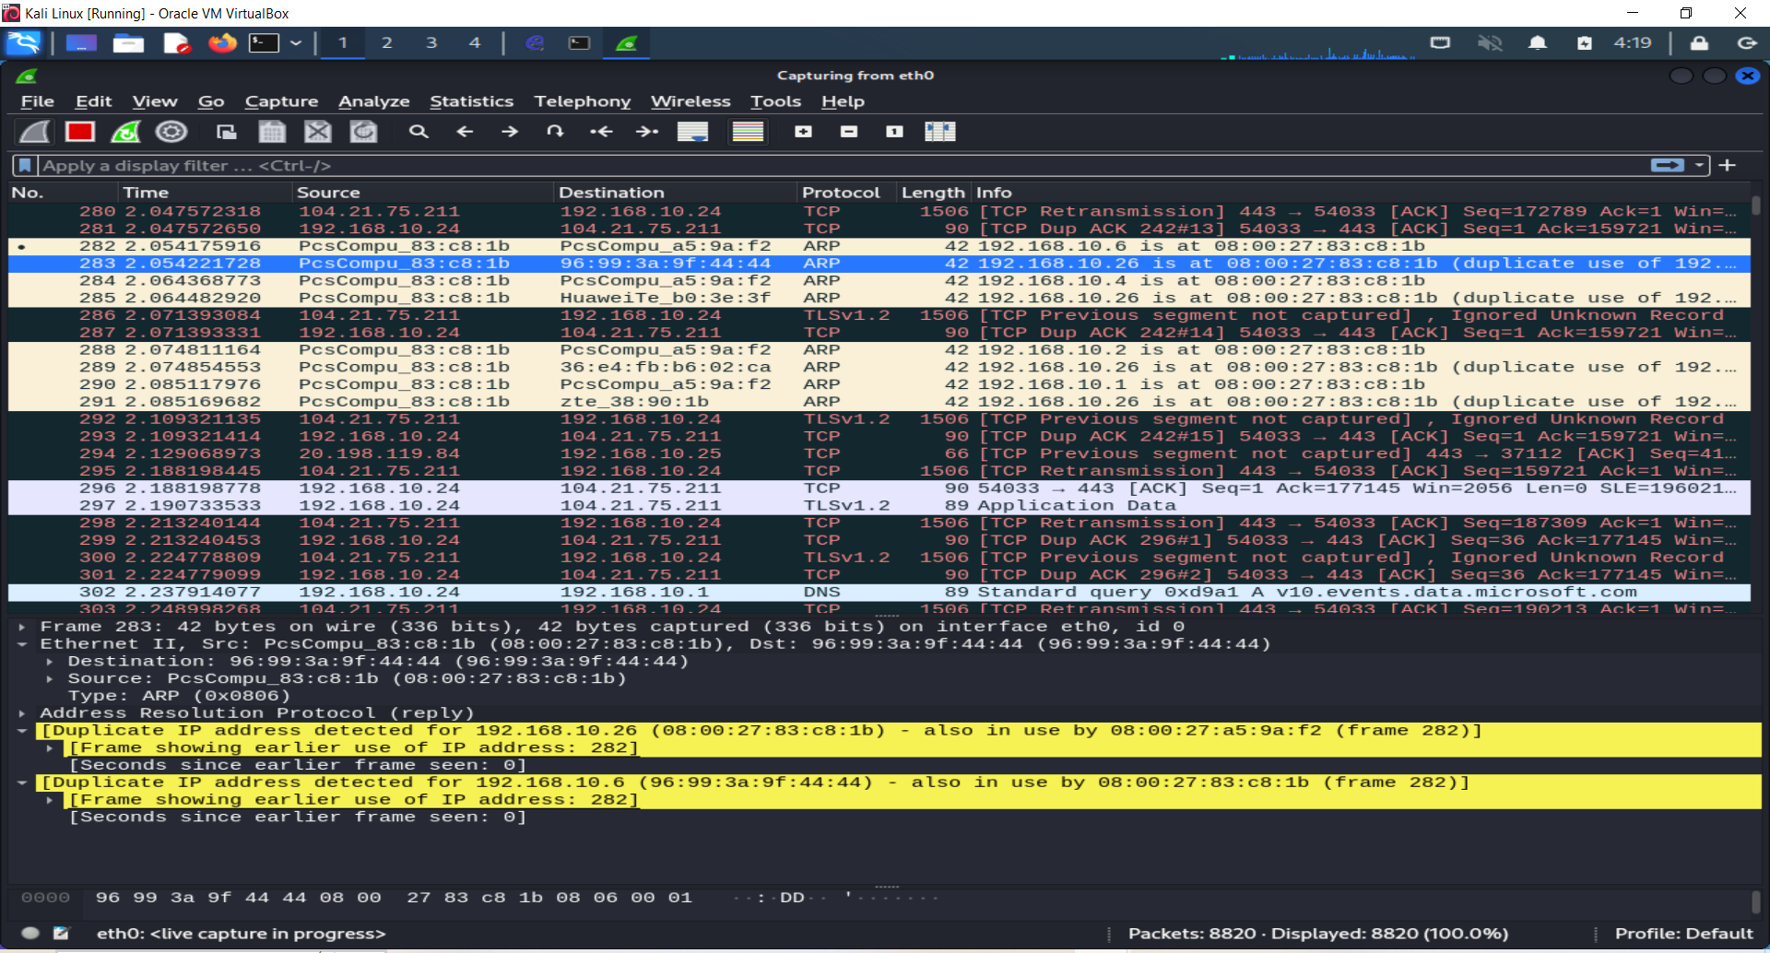
On the other side we open the target machine and trying to access google I got the following response.
See below duplication IP address detected for 192.168.10.26.

Slide 17
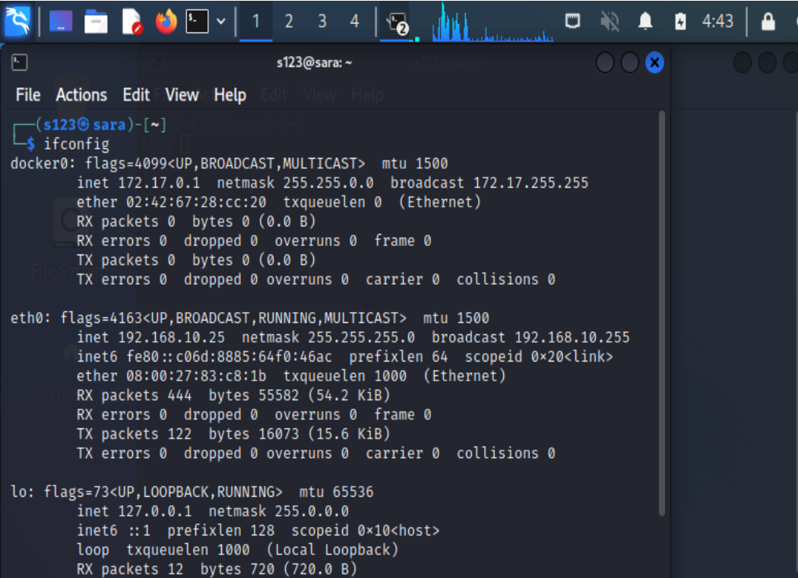
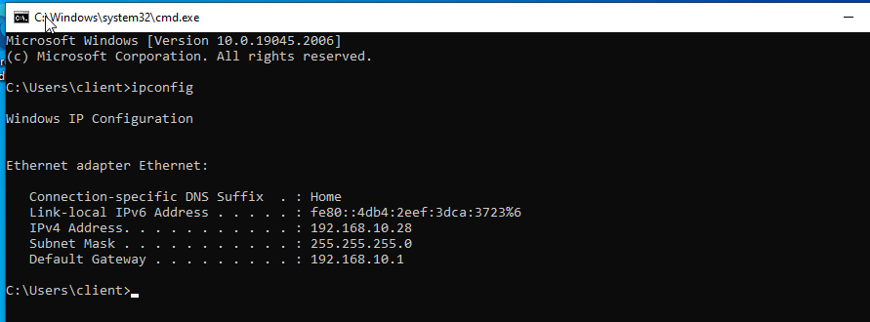
2. Arp Spoofing Attack Utilized in local area networks (LANs) to convert IP addresses to physical MAC. It is associate the attacker's MAC address with the IP address of another host, such as the default gateway, causing any traffic meant for that IP address to be sent to the attacker instead
The IP address Kali Linux machine
The IP address of Windows machine

Slide 18
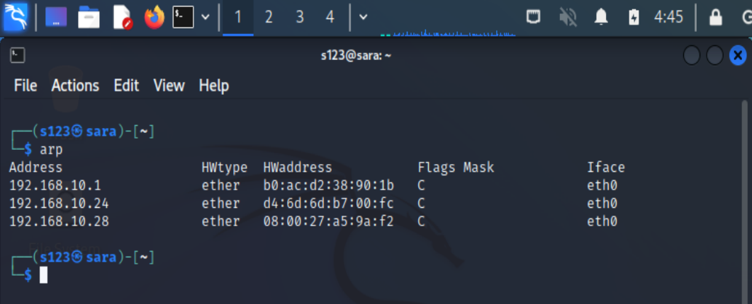
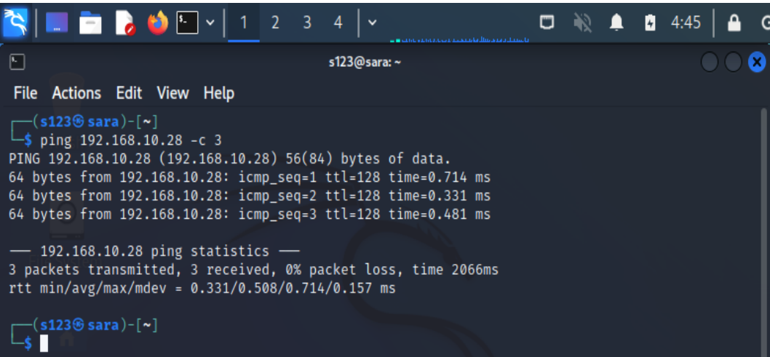
Ping the target machine to verify and add its IP address to your ARP table
view the ARP table.

Slide 19
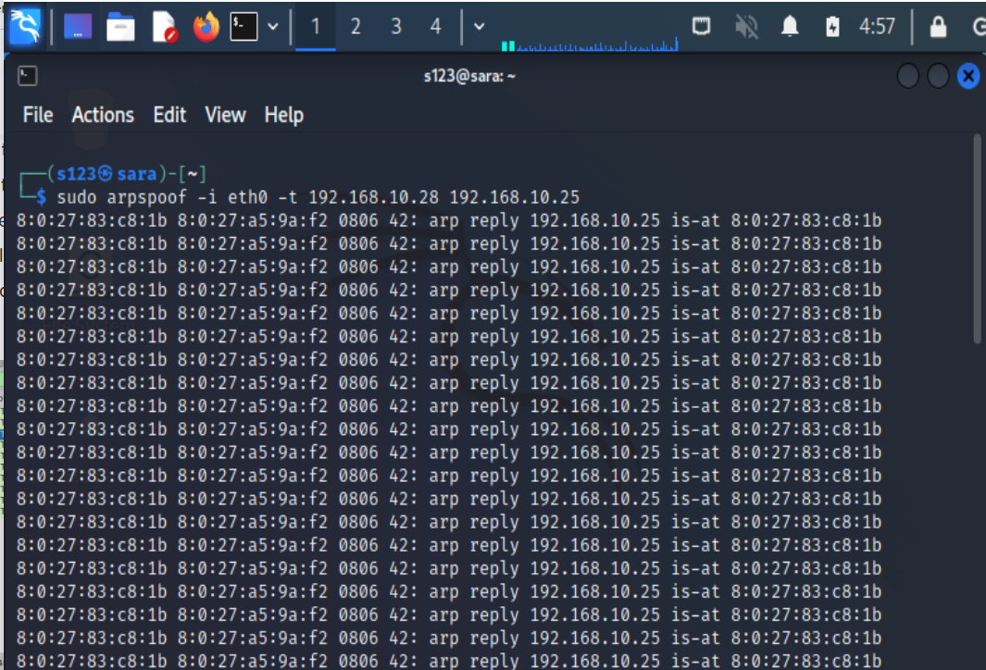
Here in output, you can see we are sending message in that message we are spoofing on the target system on this network.

Slide 20
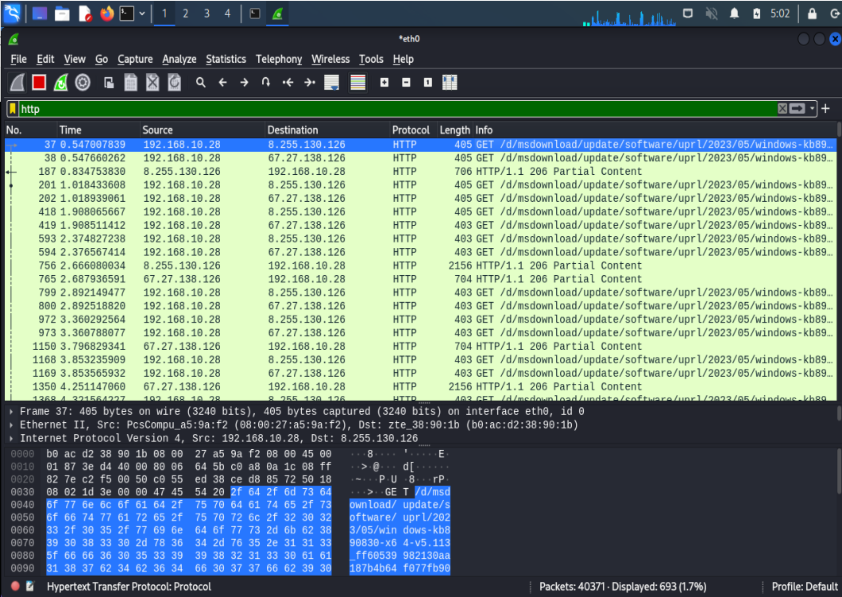
Here you can see all the http traffic of target machine is shown and its spoofed and I am monitoring through Wireshark on my attacker machine.

Slide 21
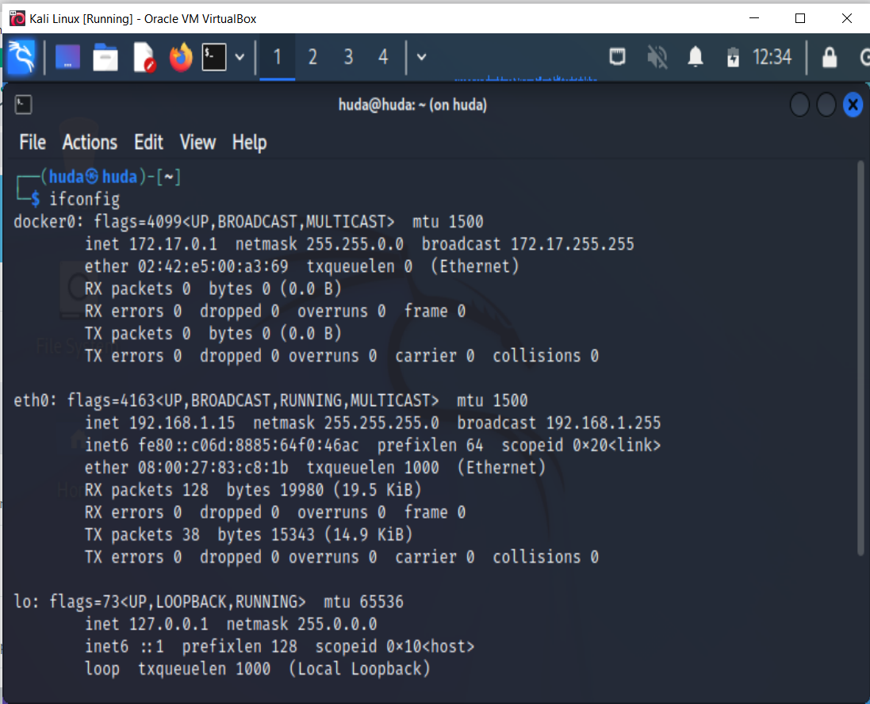
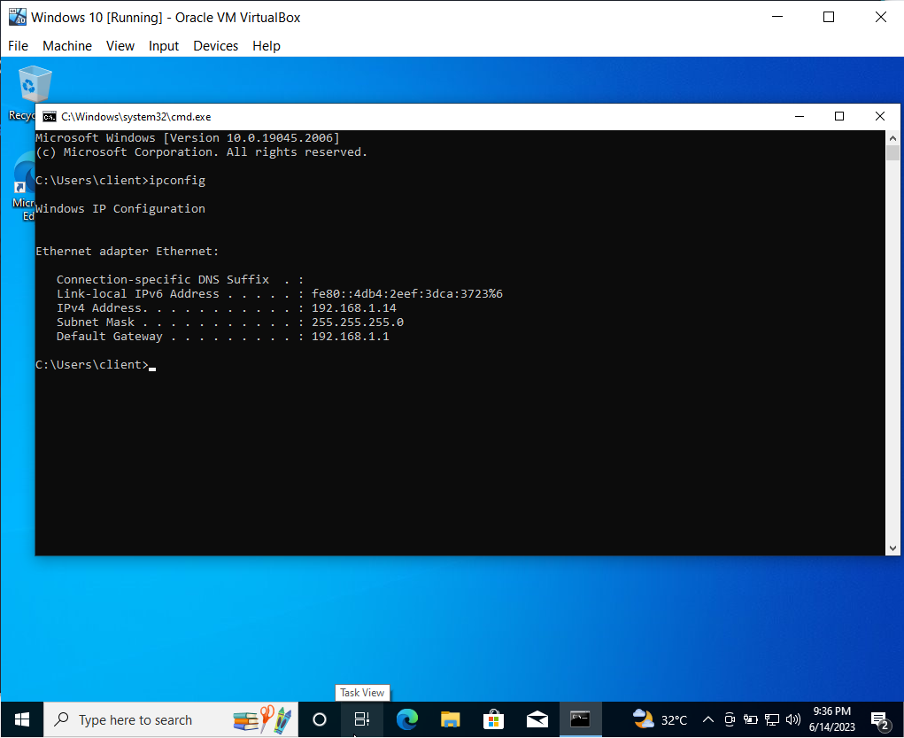
3. DoS Attack Attacker endeavors to cripple a network or server by overwhelming it with a massive amount of traffic, rendering it inaccessible to authorized users.
IP address of Kali
IP address of Windows

Slide 22
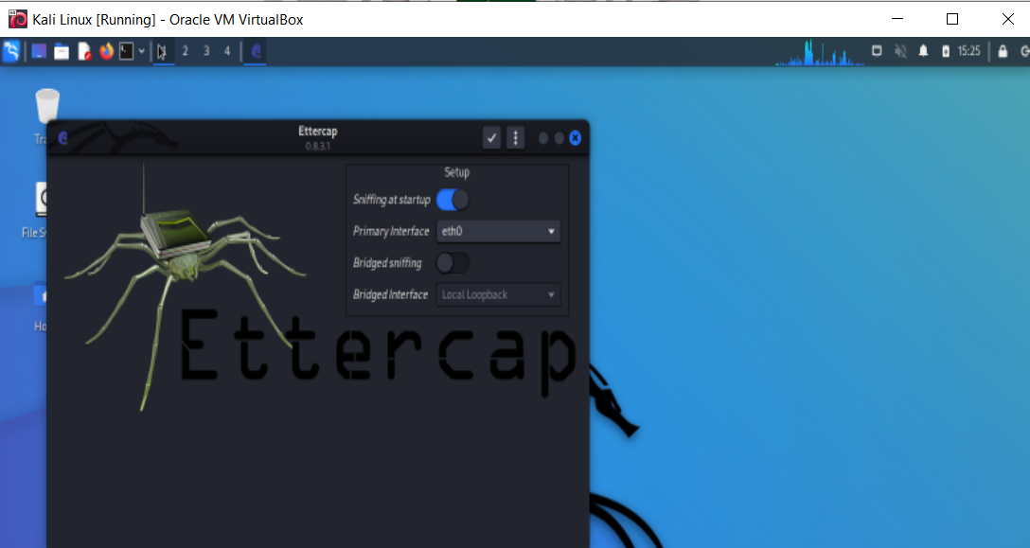
launched Ettercap

Slide 23
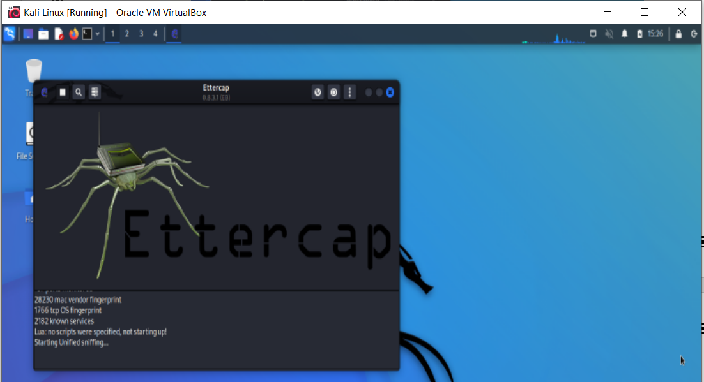

Slide 24
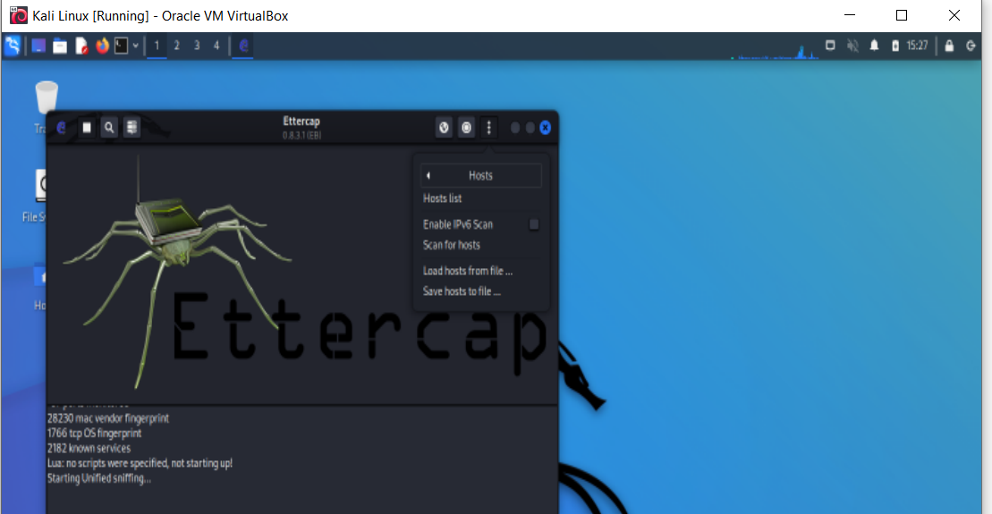

Slide 25
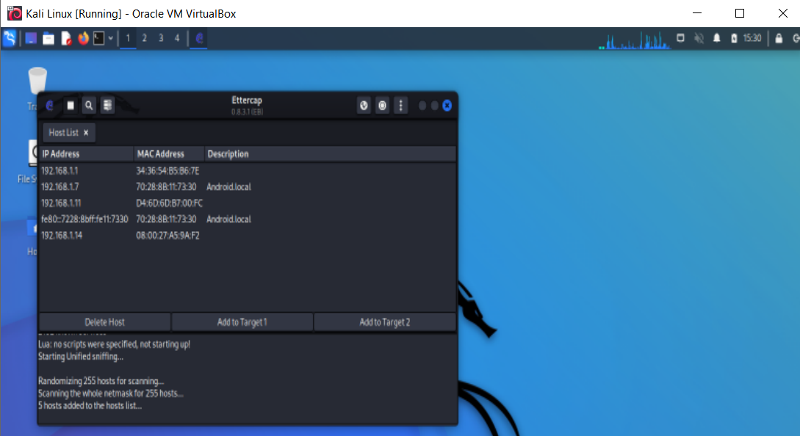
Host list

Slide 26
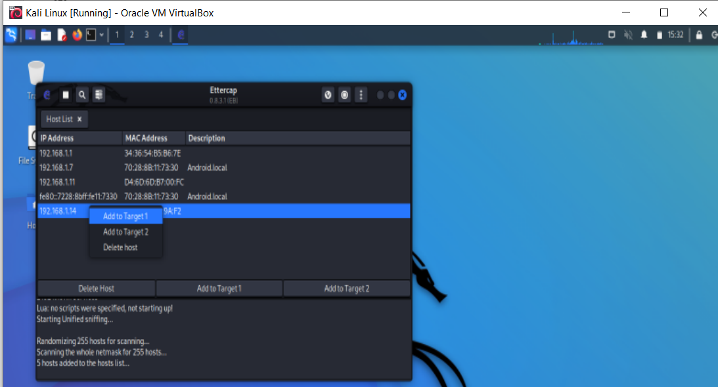
Added windows host to target 1

Slide 27
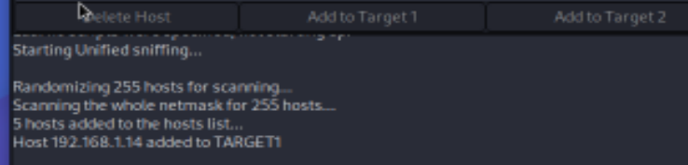
target 1

Slide 28
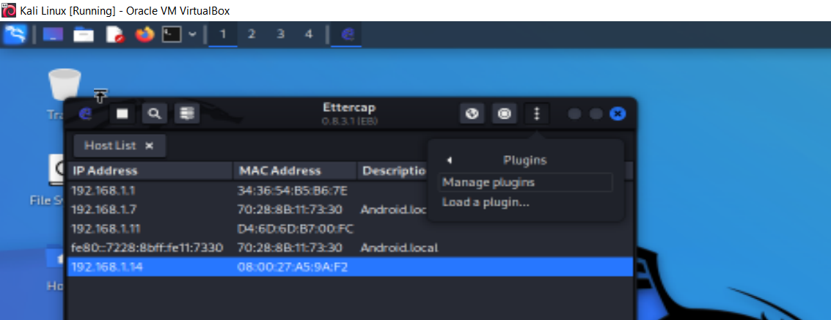
Manage plugins

Slide 29
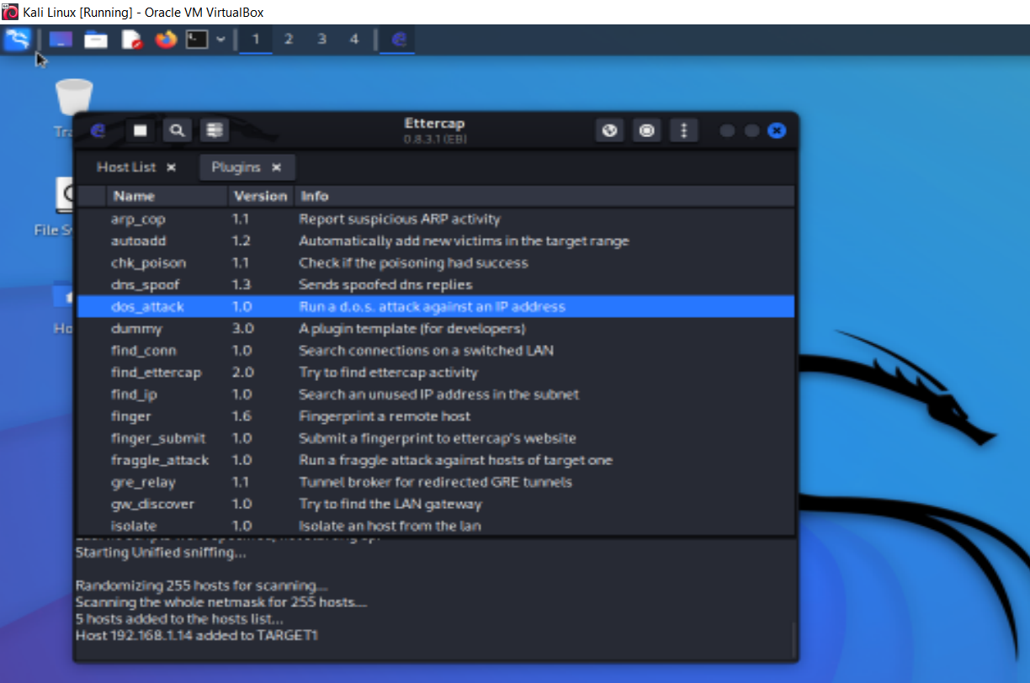
doS_attack plugin

Slide 30
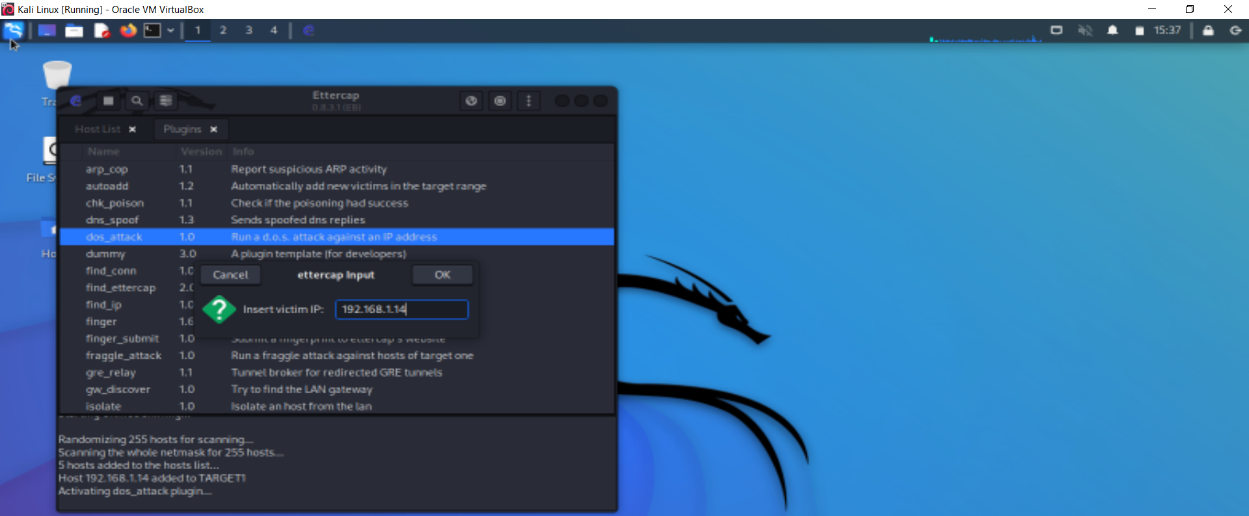
mentioned target IP

Slide 31
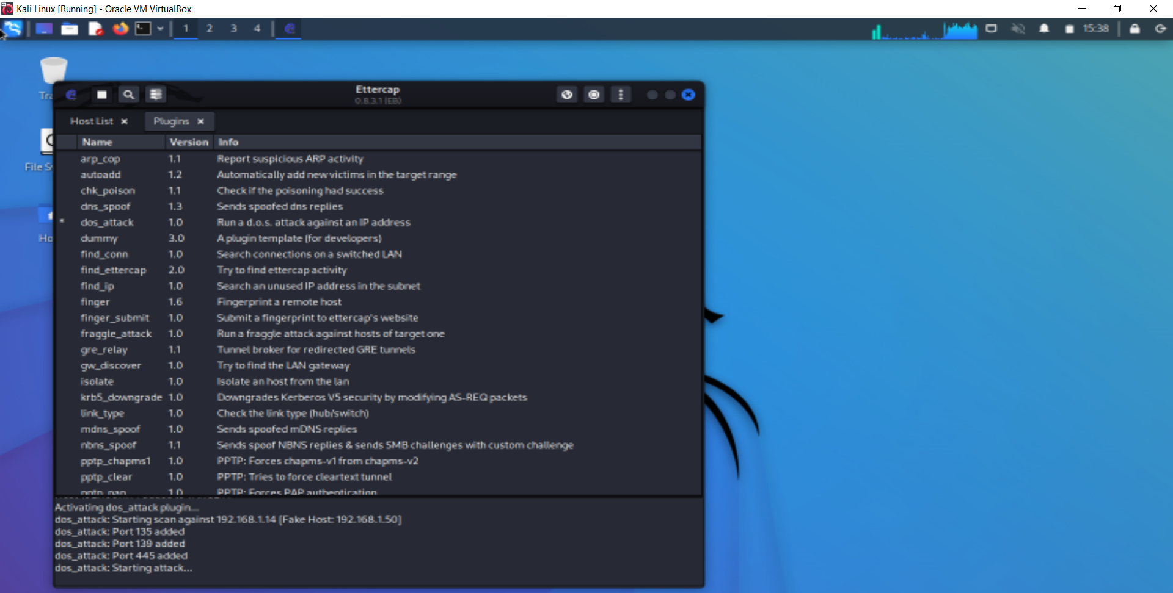

Slide 32
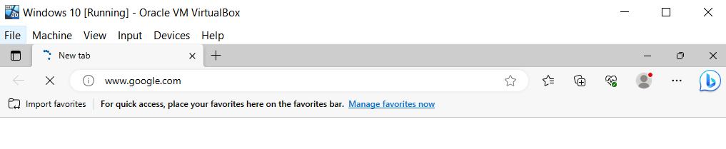
browsing on target VM

Slide 33
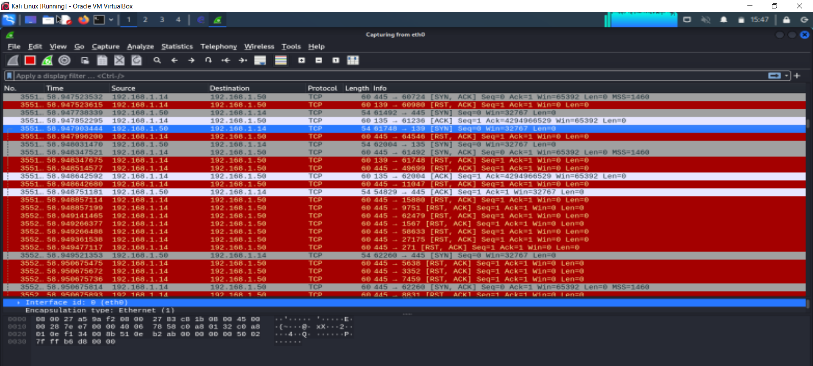

Slide 34
Conclusion
Based on the analysis of the network security assessment and forensic investigation, several significant findings have been identified. The evidence reveals the occurrence of a Man-in-the-Middle (MitM) attack, ARP spoofing attack, and Denial-of-Service (DoS) attack. These simulated attacks have exposed vulnerabilities in the network infrastructure, compromising its integrity and confidentiality.

Slide 35
Reference
Corey, V., Peterman, C., Shearin, S., Greenberg, M. S., & Van Bokkelen, J. (2002). Network forensics analysis. IEEE Internet Computing, 6(6), 60-66.
Meghanathan, N., Allam, S. R., & Moore, L. A. (2010). Tools and techniques for network forensics. arXiv preprint arXiv:1004.0570.
Ndatinya, V., Xiao, Z., Manepalli, V. R., Meng, K., & Xiao, Y. (2015). Network forensics analysis using Wireshark. International Journal of Security and Networks, 10(2), 91-106.
Hunt, R., & Zeadally, S. (2012). Network forensics: an analysis of techniques, tools, and trends. Computer, 45(12), 36-43.
Sikos, L. F. (2020). Packet analysis for network forensics: A comprehensive survey. Forensic Science International: Digital Investigation, 32, 200892.
Saad, S., & Traore, I. (2010, August). Method ontology for intelligent network forensics analysis. In 2010 Eighth International Conference on Privacy, Security and Trust (pp. 7-14). IEEE.

Slide 36
Thank you
Any questions

